Slide 1
UML to Relations
Dr. Shaheen Khatoon
Application
program
DBMS
End-user
1-<number>

Slide 2
High-Level Database Design Model
User-friendly (graphical) specification language
Translated into model of DBMS

Slide 3
Unified Modeling Language (UML)
Data modeling subset
  5 concepts
    Classes
    Associations
    Association Classes
    Subclasses
    Composition & Aggregation
  Designs can be translated to relations automatically
    Provided every “regular” class has a key

Slide 4
UML to Relations: Classes
Every class becomes a relation; pk → primary key
Student
SID PK SName GPA
<Methods>
College
CName PK State
<Methods>
Student ( SID, SName, GPA)
College( CName, State)

Slide 5
UML to Relations: Associations
Relation with key from each side
Student
SID PK SName GPA
<Methods>
College
CName PK State
<Methods>
Applied
AppInfo
Date Decision
<Methods>
Student ( SID, SName, GPA)
College( CName, State)
AppInfo( SID, CName, Date, Decision)

Slide 6
Keys for Association Relations
Depends on multiplicity
Student
SID PK SName GPA
<Methods>
College
CName PK State
<Methods>
*
Applied
1..1
*
*
AppInfo
Date Decision
<Methods>
Student ( SID, SName, GPA, CNAme)
College( CName, State)
AppInfo( SID, CName, Date, Decision)
AppInfo( SID, CName, Date, Decision)

Slide 7
Association Relation Always Needed?
Depends on multiplicity
Student
SID PK SName GPA
<Methods>
College
CName PK State
<Methods>
*
Applied
1..1
*
0..1
AppInfo
Date Decision
<Methods>
Student ( SID, SName, GPA, CName, Date, Decision)
College( CName, State)

Slide 8
Suppose we had 0..2 on the right-hand side, so students can apply to up to 2 colleges? Is there still a way to "fold in" the association relation in this case, or must we have a separate Applied relation?
Explanation
We might create relation Student(sID,sName,GPA,cName1,cName2),
assuming null values are allowed.
We can similarly fold in any 0..N or M..N multiplicity, although the bigger N is, the less sense this translation makes.
1-<number>

Slide 9
Self-Associations
Student
SID PK SName GPA
*
Sibling
*
Student ( SID, SName, GPA)
Sibling (SID1, SID)

Slide 10
Self-Associations
College
CName PK State Enrollment
Home
1..1
Branch
0..10
Satellite
College (CName, State, Enrollment
Branch (Home, Satellite)
CName

Slide 11
UML Data Modeling: 5 concepts
  Classes
  Associations
  Association Classes
  Subclasses
  Composition & Aggregation

Slide 12




Subclasses
1) Subclass relations contain superclass key + specialized attrs.
2) Subclass relations contain all attributes
3) One relation containing all superclass + subclass attrs.
S
K PK A
1: S( K, A), S1 (K, B) S2(K, C)
2: S( K, A), S1 (K, A, B) S2(K, A, C)
3: ( K, A, B, C)
Best translation may depend on properties
Heavily overlap design 3
Disjoint complete: Design 2
S1 (K, A, B) S2(K, A, C)

Slide 13
Subclasses – Example: Using Design 1
Student
SID PK SName GPA
<Methods>
APInfo
Year Grade
ForeignS
Country
DomesticS
State SSN
AP
APCourses
courseNo PK Title
1..*
1..10
Took
Student ( SID, SName, GPA)
ForeignS (SID, Country)
DomesticS (SID, State, SSN)
AP(SID)
APCourse( CourseNo, Title)
AppInfo( SID, CourseNo, Year, Grade)

Slide 14
UML Data Modeling: 5 concepts
  Classes
  Associations
  Association Classes
  Subclasses
  Composition & Aggregation

Slide 15
Composition & Aggregation
College
Cname PK State
<Methods>
Department
dname building
<Methods>
1..1
College( CName, State)
Department( dname, building, CName)

Slide 16
Aggregation
College
CName PK State
<Methods>
Apartment
Address PK #units
<Methods>
0..1
College( CName, State)
Apartment( Address, #units, CName)
Null
1-<number>

Slide 17
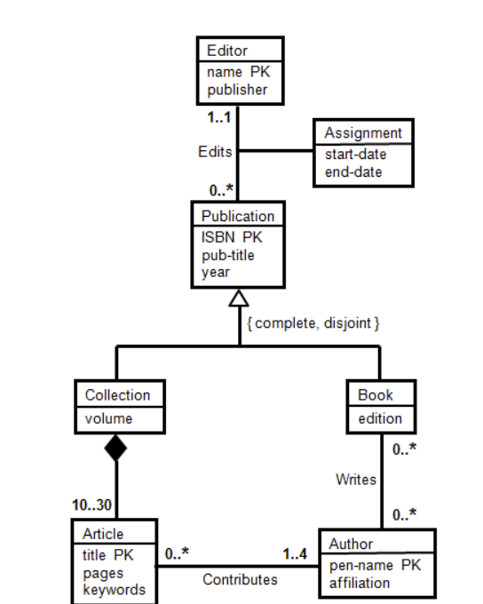
Homework
Translate this UML into relations
1-<number>

Slide 18
UML: High-Level Database Design Model
User-friendly graphical specification language
Designs translated to relations automatically

Slide 19
Summary
Higher-Level Database Design
  Unified Modeling Language (UML)
    Data modeling subset
  Graphical
  5 concepts
    Classes
    Associations
    Association Classes
    Subclasses
    Composition & Aggregation
  Can be translated to relations automatically

